Slide 1

Object Oriented Programming with Java
Day 4

Slide 2
Understanding Blocks and Scope
Blocks
  Use opening and closing curly braces
  Can exist entirely within another block or entirely outside of and separate from another block
  Cannot overlap
  Types:
    Outside block (or outer block)
    Inside block (or inner block)
    Nested (the inner block is contained entirely within the outside block)

Slide 3
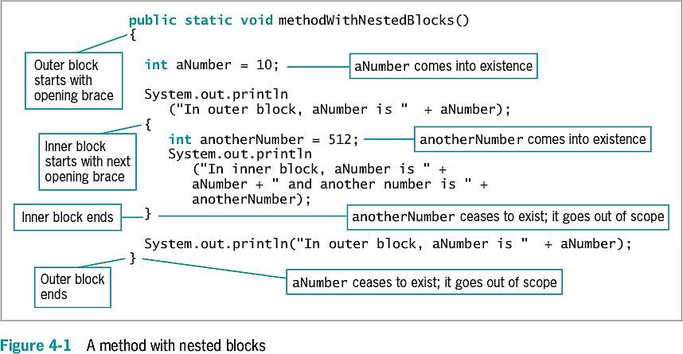
Understanding Blocks and Scope

Slide 4
Understanding Blocks and Scope
Scope
  The portion of a program within which you can refer to a variable
  Comes into scope
    Variable comes into existence
  Goes out of scope
    Variable ceases to exist
Re-declaring the variable
  You cannot declare the same variable name more than once within a block
  An illegal action

Slide 5
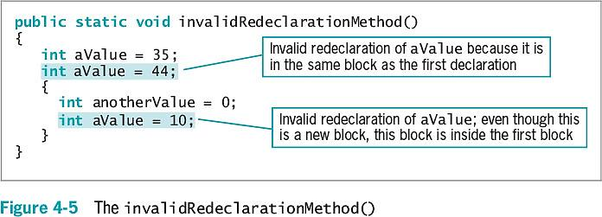
Understanding Blocks and Scope

Slide 6
Understanding Blocks and Scope
Override
  Occurs when you use the variable’s name within the method in which it is declared
    The variable takes precedence over any other variable with the same name in another method
  Shadowing: locally declared variables always mask or hide other variables with the same name elsewhere in the class

Slide 7
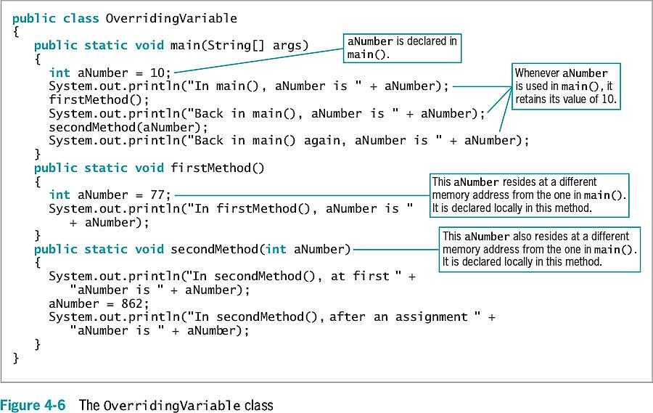
Understanding Blocks and Scope

Slide 8
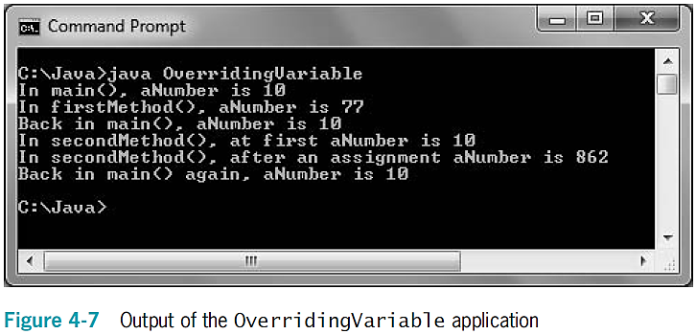
Understanding Blocks and Scope

Slide 9
Overloading a Method
Overloading
  Using one term to indicate diverse meanings
  Writing multiple methods with the same name but with different arguments
  The compiler understands the meaning based on the arguments used with the method call
  It is convenient for programmers to use one reasonable name
    For tasks that are functionally identical
    Except for argument types

Slide 10
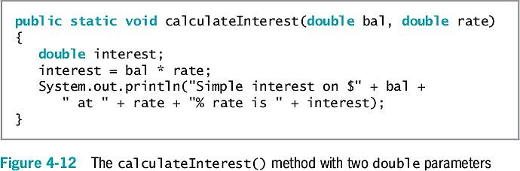
Overloading a Method

Slide 11
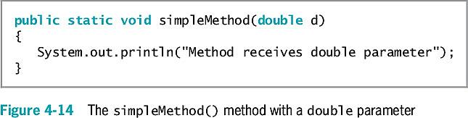
Automatic Type Promotion in Method Calls
If an application contains just one version of a method:
  Call the method using a parameter of the correct data type or one that can be promoted to the correct data type
    Order of promotion:
      double, float, long, int

Slide 12
Learning About Ambiguity
Ambiguous situation
  When the compiler cannot determine which method to use
Overload methods
  Correctly provide different parameter lists for methods with the same name
Illegal methods
  Methods with identical names that have identical argument lists but different return types
  Can such methods be created? Will Java attempt to resolve them, throw a compile exception or runtime exception?

Slide 13
Exercise
What do you call the code between a pair of curly braces?
The portion of a program within which you can reference a variable is called the variable’s _____.
Can you declare the same variable multiple times in the same method? What about different methods? Explain your answer.

Slide 14
Creating and Calling Constructors with Parameters
Java automatically provides a constructor method when class-created default constructors do not require parameters
Writing your own constructor method:
  Ensures that fields within classes are initialized to appropriate default values
  Constructors can receive parameters
    Used for initialization purposes

Slide 15
Creating and Calling Constructors with Parameters
When you write a constructor for a class, you no longer receive the automatically provided default constructor
If a class’s only constructor requires an argument, you must provide an argument for every object of the class

Slide 16
Overloading Constructors
Use constructor parameters to initialize field values, or any other purpose
If constructor parameter lists differ, there is no ambiguity about which constructor method to call

Slide 17
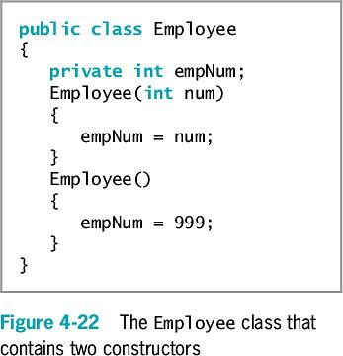
Overloading Constructors

Slide 18
Learning About the this Reference
Instantiating an object from a class
  Memory is reserved for each instance field in the class
  It is not necessary to store a separate copy of each variable and method for each instantiation of a class
In Java:
  One copy of each method in a class is stored
  All instantiated objects can use one copy

Slide 19
Learning About the this Reference
Reference
  An object’s memory address
  Implicit
    Automatically understood without actually being written

Slide 20
Learning About the this Reference
this reference
  The reference to an object
  Passed to any object’s nonstatic class method
  A reserved word in Java
You do not need to use the this reference in methods you write in most situations

Slide 21
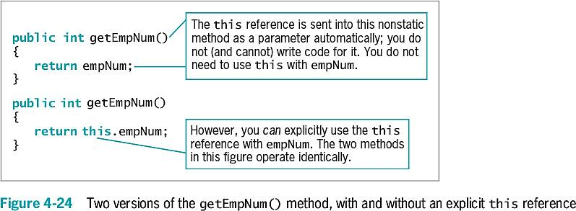
Learning About the this Reference

Slide 22
Learning About the this Reference
this reference (cont’d.)
  Implicitly received by instance methods
  Use to make classes work correctly
  When used with a field name in a class method, the reference is to the class field instead of to the local variable declared within the method

Slide 23
Using the this Reference to Make Overloaded Constructors More Efficient
Avoid repetition within constructors
Constructor calls other constructor
  this()
  More efficient and less error-prone

Slide 24
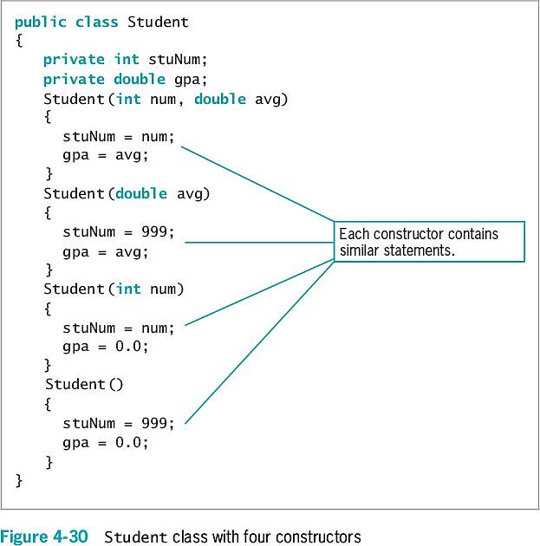
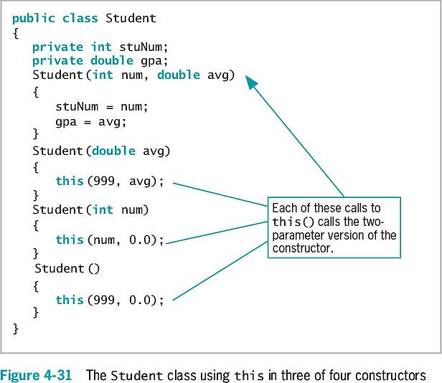

Slide 25
Using static Fields
Class methods
  Do not have the this reference
  Have no object associated with them
  (Such as the main method)
Class variables
  Shared by every instantiation of a class
  Only one copy of a static class variable per class

Slide 26
Using Constant Fields
Create named constants using the keyword final
  Make its value unalterable after construction
Can be set in the class constructor
  After construction, you cannot change the final field’s value

Slide 27
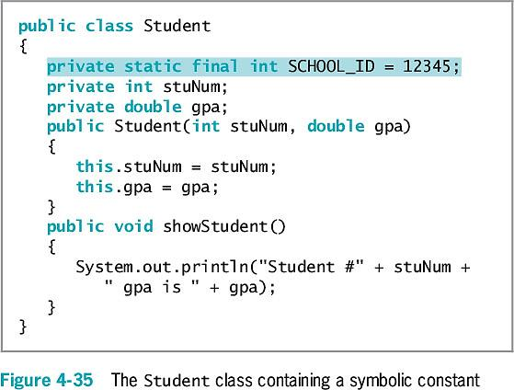
Using Constant Fields
Notes:
Why are final fields usually defined as static?

Slide 28
Using Automatically Imported, Prewritten Constants and Methods
Many classes are commonly used by a wide variety of programmers
Package or library of classes
  A folder that provides a convenient grouping for classes
  Many contain classes available only if they are explicitly named within a program
  Some classes are available automatically

Slide 29
Using Automatically Imported, Prewritten Constants and Methods
java.lang package
  Implicitly imported into every Java program
  The only automatically imported, named package
  The classes it contains are fundamental classes (or basic classes)
Optional classes
  Must be explicitly named

Slide 30
Using Automatically Imported, Prewritten Constants and Methods
java.lang.Math class
  Contains constants and methods used to perform common mathematical functions
  No need to create an instance
  Imported automatically
  Cannot instantiate objects of type Math
    The constructor for the Math class is private

Slide 31
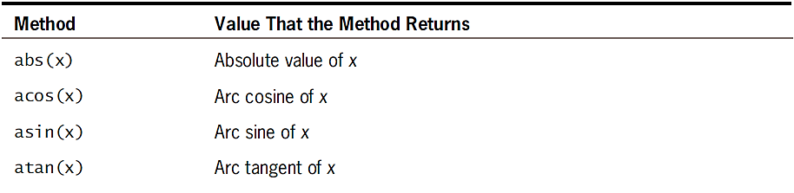
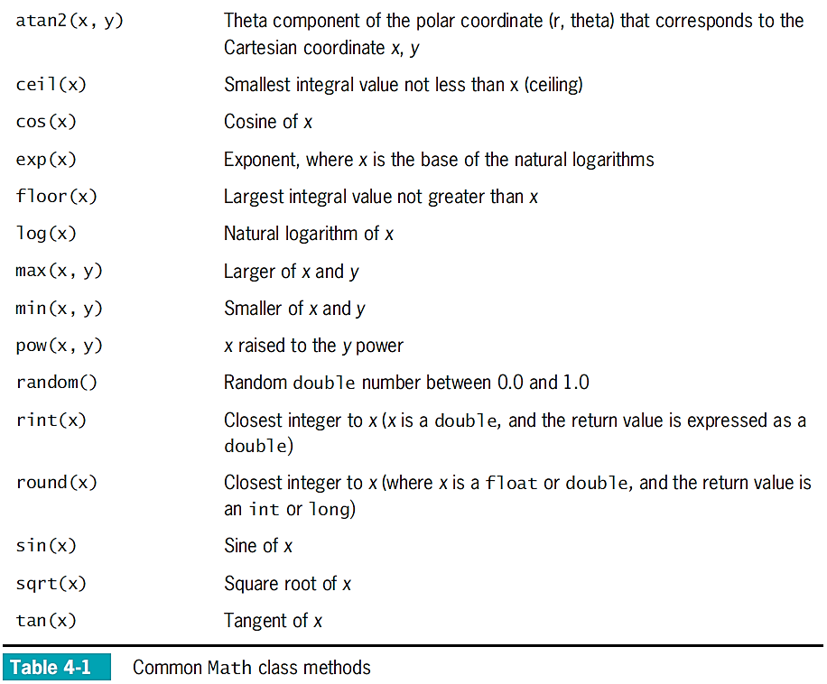

Slide 32
Importing Classes That Are Not Imported Automatically
Use prewritten classes
  Use the entire path with the class name
  Import the class
  Import the package that contains the class

Slide 33
Importing Classes That Are Not Imported Automatically
Wildcard symbol
  An alternative to importing the class
    Import the entire package of classes
  Asterisk wildcard
    Can be replaced by any set of characters
    Represents all classes in a package
    There is no disadvantage to importing extra classes
  Importing each class by name can be a form of documentation

Slide 34
Using the LocalDate Class
LocalDate class
  No time zone information included with this class (local date only)
  Static methods now() and of()
  Class constructors are non-public
  Various methods provided to perform date arithmetic
Enumeration
  Data type that consists of a list of values, such as:
    JANUARY, FEBRUARY, MARCH etc.

Slide 35
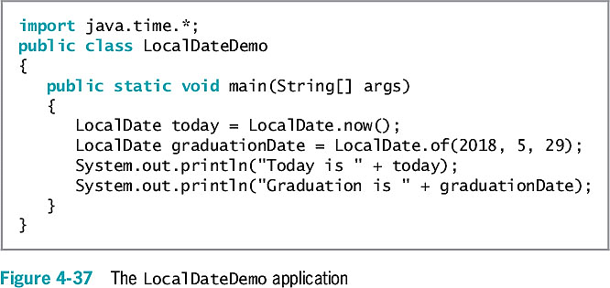
Using the LocalDate Class

Slide 36
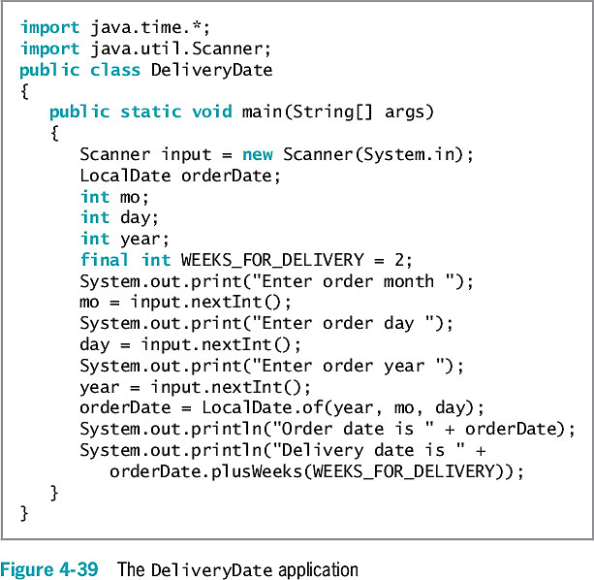
Using the LocalDate Class

Slide 37
Understanding Composition and Nested Classes
Composition
  Describes the relationship between classes when an object of one class data field is within another class
  Called a has-a relationship
    Because one class “has an” instance of another
Remember to supply values for a contained object if it has no default constructor

Slide 38
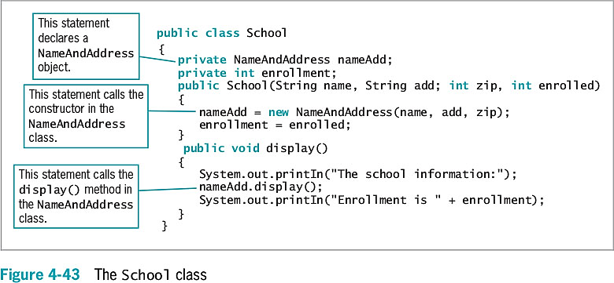
Understanding Composition and Nested Classes

Slide 39
Nested Classes
Nested classes
  A class within another class
  Stored together in one file
Nested class types
  static member classes
  Nonstatic member classes
  Local classes
  Anonymous classes

Slide 40
Summary
Variable’s scope
  The portion of a program in which you can reference a variable
Block
  Code between a pair of curly braces
Overloading
  Writing multiple methods with the same name but different argument lists
Store separate copies of data fields for each object
  But just one copy of each method

Slide 41
Summary
static class variables
  Shared by every instantiation of a class
Prewritten classes
  Stored in packages
import statement
  Notifies the Java program that class names refer to those within the imported class
A class can contain other objects as data members
You can create nested classes that are stored in the same file

